Slide 1
AC6761 Artificial Intelligence Accounting
Chapter 2 Accounting for Business Transactions

Slide 2
Explain the steps in processing transactions and the role of source documents.

Slide 3
Basis of Financial Statements
Business transactions and events are the starting points of financial statements. Process from transactions to financial statements is as follows:
Identify each transaction and event from source documents.
Analyze each transaction and event using the accounting equation.
Record relevant transactions and events in a journal.
Post journal information to ledger accounts.
Prepare and analyze the trial balance and financial statements.

Slide 4
Describe an account and its use in recording transactions.

Slide 5
The Account Underlying Financial Statements
An account is a record of increases and decreases in a specific asset, liability, equity, revenue, or expense.
The general ledger is a record of all accounts used by the company.

Slide 6
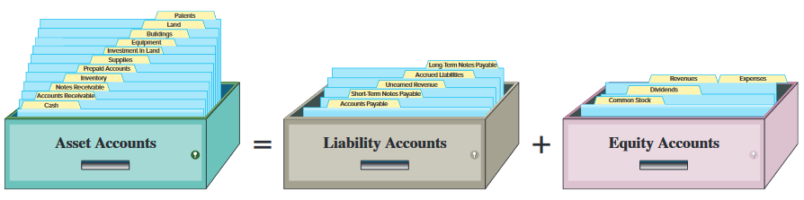
The Account and Its Analysis

Slide 7
Asset Accounts
Cash
Land
Accounts Receivable
Asset
Accounts
Buildings
Notes Receivable
Equipment
Prepaid Accounts
Supplies

Slide 8
Liability Accounts
Accounts Payable
Notes Payable
Liability
Accounts
Tax Payable
Unearned Revenue

Slide 9
Equity Accounts
-
Dividends
+
Common Stock
Equity
Accounts
+
Revenues
-
Expenses

Slide 10
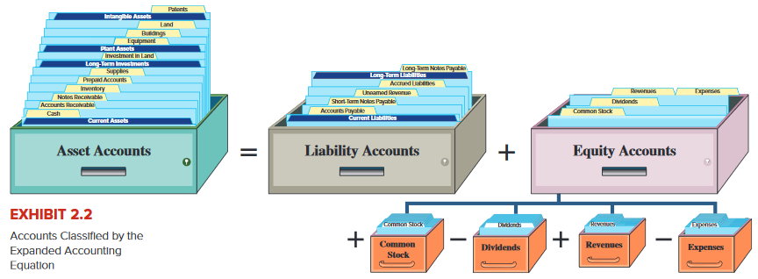
Expanded Accounting Equation
Revenues and common stock increases equity.
Expenses and dividends decrease equity.

Slide 11
Describe a ledger and a chart of accounts.

Slide 12
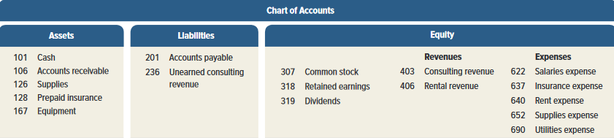
Ledger and Chart of Accounts
The ledger is a collection of all accounts and their
balances for an accounting system. A company’s
size and diversity of operations affect the number
of accounts needed.
The chart of accounts is a list of all
accounts and includes an
identifying number for each account.

Slide 13
Define debits and credits and explain double-entry accounting.

Slide 14
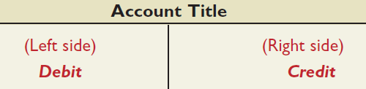
Debits and Credits
A T-account represents a ledger account and is used to show the effects of one or more transactions.
The act of entering an amount on the left side of an account is called debiting the account and making an entry on the right side is crediting the account.
When the debit amounts exceed the credits, an account has a debit balance; when the reverse is true, the account has a credit balance.

Slide 15
Double Entry System
In a double-entry system, equal debits and credits are made in the accounts for each transaction.
Thus, the total debits will always equal the total credits and the accounting equation will always stay in balance.

Slide 16
Double-Entry Accounting
=
+
Assets
Liabilities
Equity
ASSETS
LIABILITIES
EQUITIES
Debit Credit
Debit Credit
Debit Credit
+ -
- +
- +
Normal
Normal
Normal

Slide 17
Double-Entry Accounting
Equity
_
_
Common Stock
Dividends
+
Revenues
Expenses
Common Stock
Dividends
Revenues
Expenses
Debit Credit
Debit Credit
Debit Credit
Debit Credit
- +
+ -
- +
+ -

Slide 18
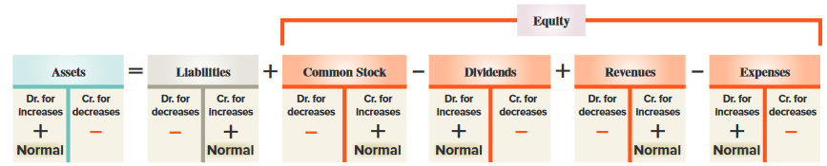
Double-Entry Accounting:
Expanded Accounting Equation
Here is the expanded accounting equation showing the equity section.

Slide 19
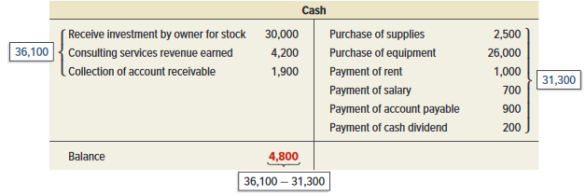
Double-Entry Accounting:
Account Balance
An account balance is the difference between the increases and decreases in an account. Notice the T-Account.

Slide 20
Record transactions in a journal and post entries to a ledger.

Slide 21
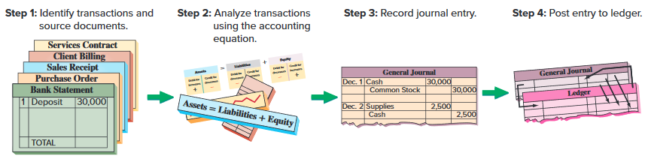
Journalizing and Posting Transactions

Slide 22
Journalizing &
Posting Transactions
In an actual accounting system, transactions are initially recorded in the journal. Journal is a chronological record of transactions.
Posting is the process of systematically copying information from the journal to the ledger accounts.
Notes:
4

Slide 23
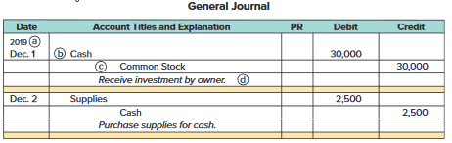
Journalizing Transactions
Transaction Date
Titles of Affected Accounts
Transaction explanation
Dollar amount of debits and credits

Slide 24
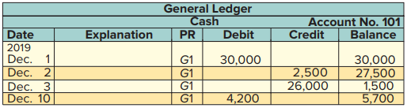
Balance Column Account
T-accounts are useful illustrations, but balance column accounts are used in practice.

Slide 25
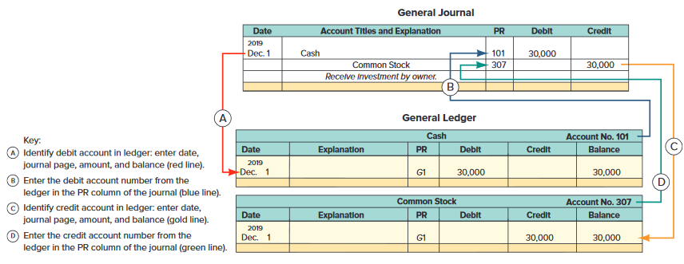
Posting Journal Entries

Slide 26
Analyze the impact of transactions on accounts and financial statements.
© McGraw-Hill Education

Slide 27
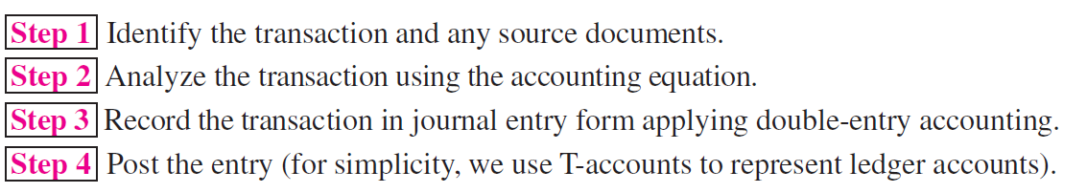
Processing Transactions
Double-entry accounting is useful in analyzing and processing transactions. Analysis of each transaction follows these four steps.

Slide 28
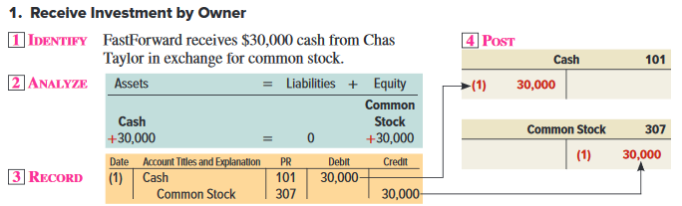
Processing Transactions #1

Slide 29
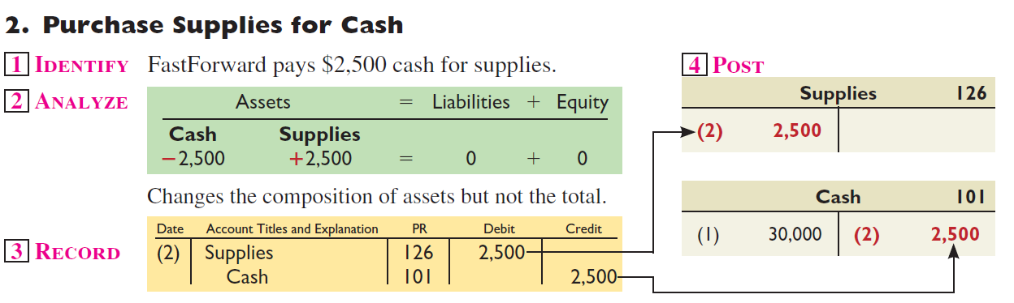
Processing Transactions #2

Slide 30
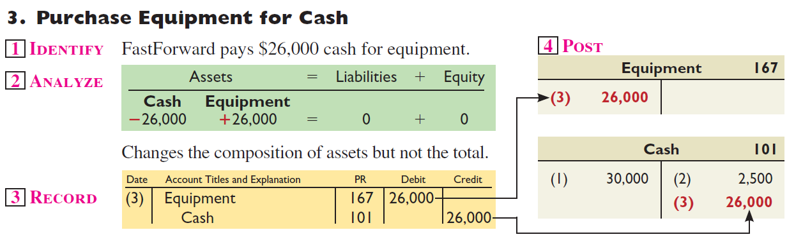
Processing Transactions #3

Slide 31
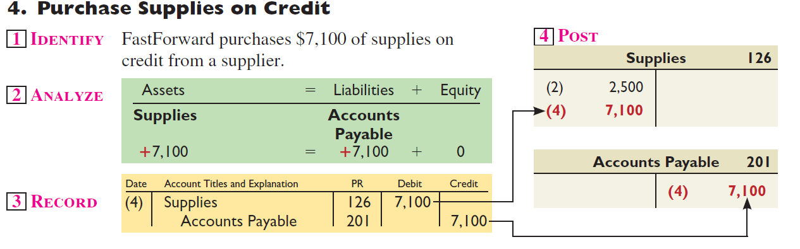
Processing Transactions #4

Slide 32
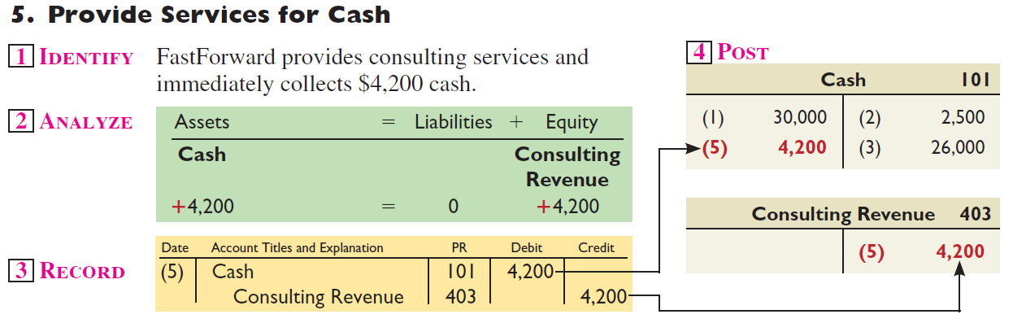
Processing Transactions #5

Slide 33
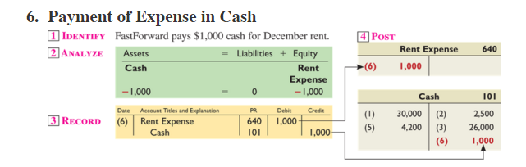
Processing Transactions #6

Slide 34
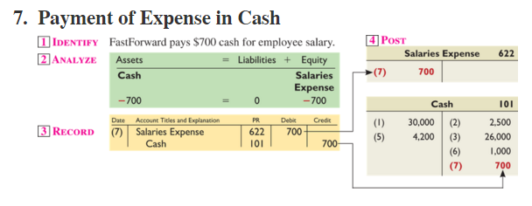
Processing Transactions #7

Slide 35
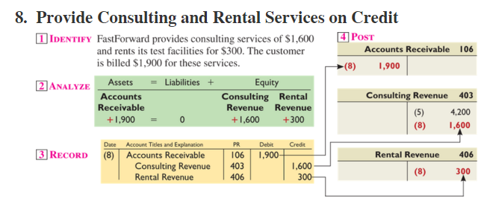
Processing Transactions #8

Slide 36
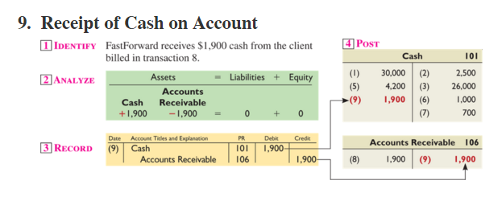
Processing Transactions #9

Slide 37
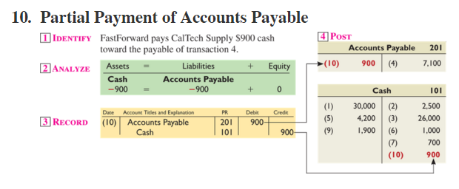
Processing Transactions #10

Slide 38
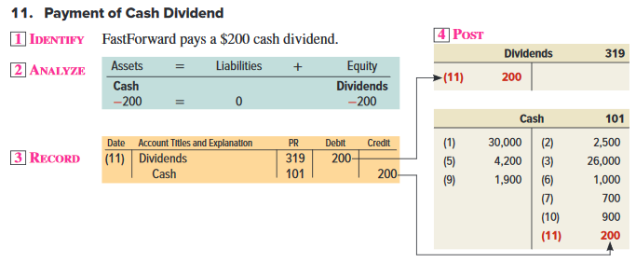
Processing Transactions #11

Slide 39
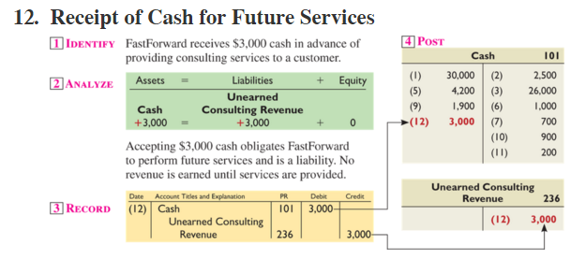
Processing Transactions #12

Slide 40
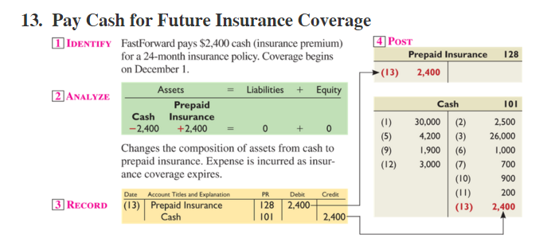
Processing Transactions #13

Slide 41
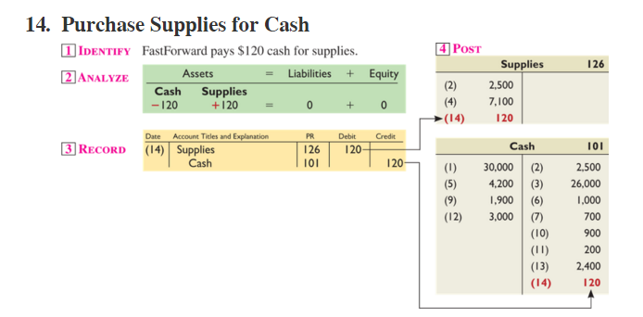
Processing Transactions #14

Slide 42
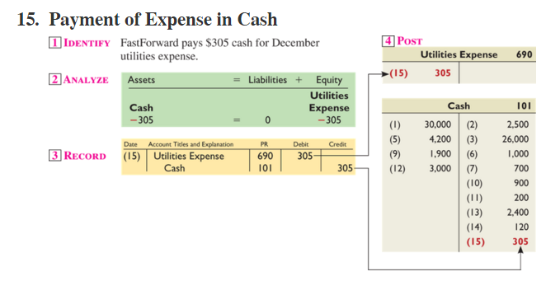
Processing Transactions #15

Slide 43
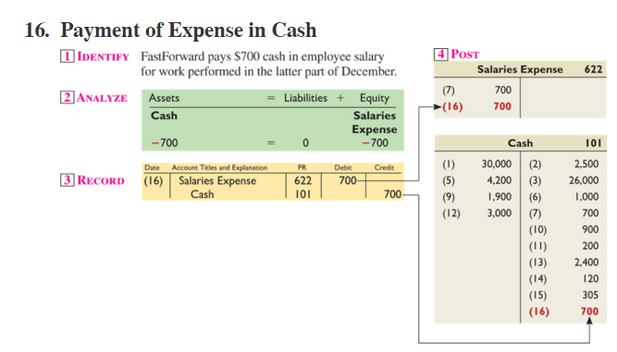
Processing Transactions #16

Slide 44
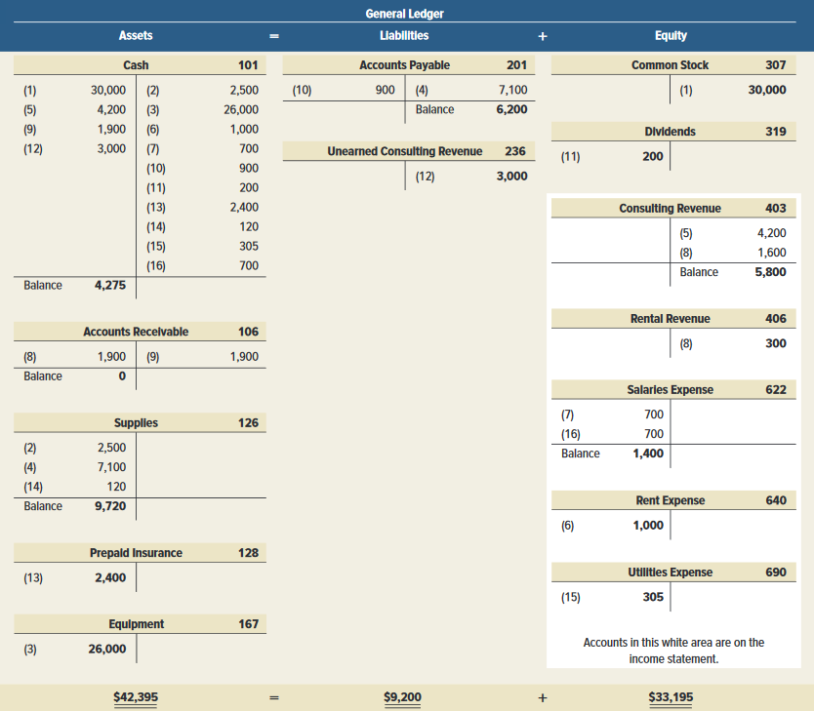
Summarizing Transactions in a Ledger

Slide 45
Prepare and explain the use of a trial balance.

Slide 46
Preparing a Trial Balance
Preparing a trial balance has three steps:
List each account title and its amount (from ledger) in the trial balance. If an account has a zero balance, list it with a zero in the normal balance column (or omit it entirely).
Compute the total of debit balances and the total of credit balances.
Verify (prove) total debit balances equal total credit balances.

Slide 47
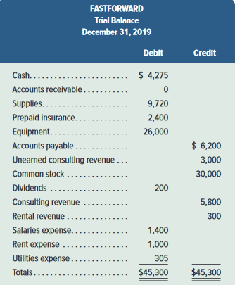
FastForward’s Trial Balance
The trial balance lists all ledger accounts and their balances at a point in time. If the books are in balance, the total debits will equal the total credits.

